Slide 1
Project Name : To find the variable that mainly affects hospital costs.
Project Perform by Vickysingh Baghel
Trainer :- Deepti Gupta

Slide 2
Business Problem :- To Predict The Hospital Cost. Business Solution :- To Build The ,Multiple Linear Regression Model
Dependent Variable :- Hospital Cost(Totchg)
Independent Variable :- Rest of All others.
1) Age Age of the patient discharged
2)Female A binary variable that indicates if the patient is female
3)Los Length of stay in days
4)Race Race of the patient (specified numerically)
5Aprdrg All Patient Refined Diagnosis Related Groups

Slide 3
MODEL INTERPREATION FOR MODEL 1:
P VALUES OF AGE,LOS,APRDRG IS LESS THAN 0.05 THEREFORE ALL THOSE VARIABLES ARE SIGNIFICANT.
P VALUE OF AGE IS ……. , P VALUE OF LOS IS……., AND P VALUE OF APRDRG IS ……
THE SLOPE OF SIGINIFICANT VARIABLES WITH DEPENDENT VARIABLE ARE
1) SLOPE FOR AGE :- 105.5034
2) SLOPE FOR LOS:- 731.9136
3) SLOPE FOR APRDRG :- -7.1984
THE RELATIONSHIP BETWEEN SLOPE OF SIG VAR AND DEP VAR. ACCORDING TO SLOPE OF SIGNIFICANT VARIABLES:-
THE AGE OF THE PATIENT DISCHARGED INCREASE THEN HOSPITAL COST ARE ALSO INCREASE BECAUSE AGE IS DIRECTLY PROPORTIONAL TO HOSPITAL COST.
LENGTH OF STAY IS INCREASE THEN HOSPITAL COST ARE ALSO INCREASE BECAUSE LENGTH OF STAY IS DIRECTLY PROPORTIONAL TO HOSPITAL COST
ALL PATIENT REFINED DIAGNOSIS RELATED GROUP IS INCREASE THEN HOSPITAL COST IS DECREASE BECAUSE APRDRG IS INVERSELY PROPORTIONAL TO HOSPITAL COST
R SQUARE VALUE IS 0.6921 & ADJUSTED R SQUARE VALUE IS 0.6876 FOR MODEL1 ITS MEANS THAT 69.21% OF THE HOSPITAL COST(DP) IS EXPLAINED BY AGE,LOS,APRDRG.

Slide 4
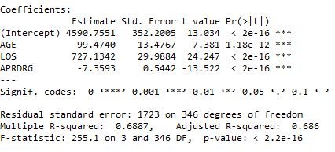
MODEL INTERPRETATION FOR MODEL 2( RERUN THE MODLE USING ONLY SIG VAR)
P VALUES OF AGE,LOS,APRDRG IS LESS THAN 0.05 THEREFORE ALL THOSE VARIABLES ARE SIGNIFICANT.
P VALUE OF AGE IS ……. , P VALUE OF LOS IS……., AND P VALUE OF APRDRG IS ……
THE SLOPE OF SIGINIFICANT VARIABLES WITH DEPENDENT VARIABLE ARE
1) SLOPE FOR AGE :- 99.4740
2) SLOPE FOR LOS:- 727.1342 3) SLOPE FOR APRDRG :- -7.3593
THE RELATIONSHIP BETWEEN SLOPE OF SIG VAR AND DEP VAR. ACCORDING TO SLOPE OF SIGNIFICANT VARIABLES:-
THE AGE OF THE PATIENT DISCHARGED INCREASE THEN HOSPITAL COST ARE ALSO INCREASE BECAUSE AGE IS DIRECTLY PROPORTIONAL TO HOSPITAL COST.
LENGTH OF STAY IS INCREASE THEN HOSPITAL COST ARE ALSO INCREASE BECAUSE LENGTH OF STAY IS DIRECTLY PROPORTIONAL TO HOSPITAL COST
ALL PATIENT REFINED DIAGNOSIS RELATED GROUP IS INCREASE THEN HOSPITAL COST IS DECREASE BECAUSE APRDRG IS INVERSELY PROPORTIONAL TO HOSPITAL COST
R SQUARE VALUE IS 0.6887 & ADJUSTED R SQUARE VALUE IS 0.686 FOR MODEL1 ITS MEANS THAT 69.21% OF THE HOSPITAL COST(DP) IS EXPLAINED BY AGE,LOS,APRDRG.

Slide 5
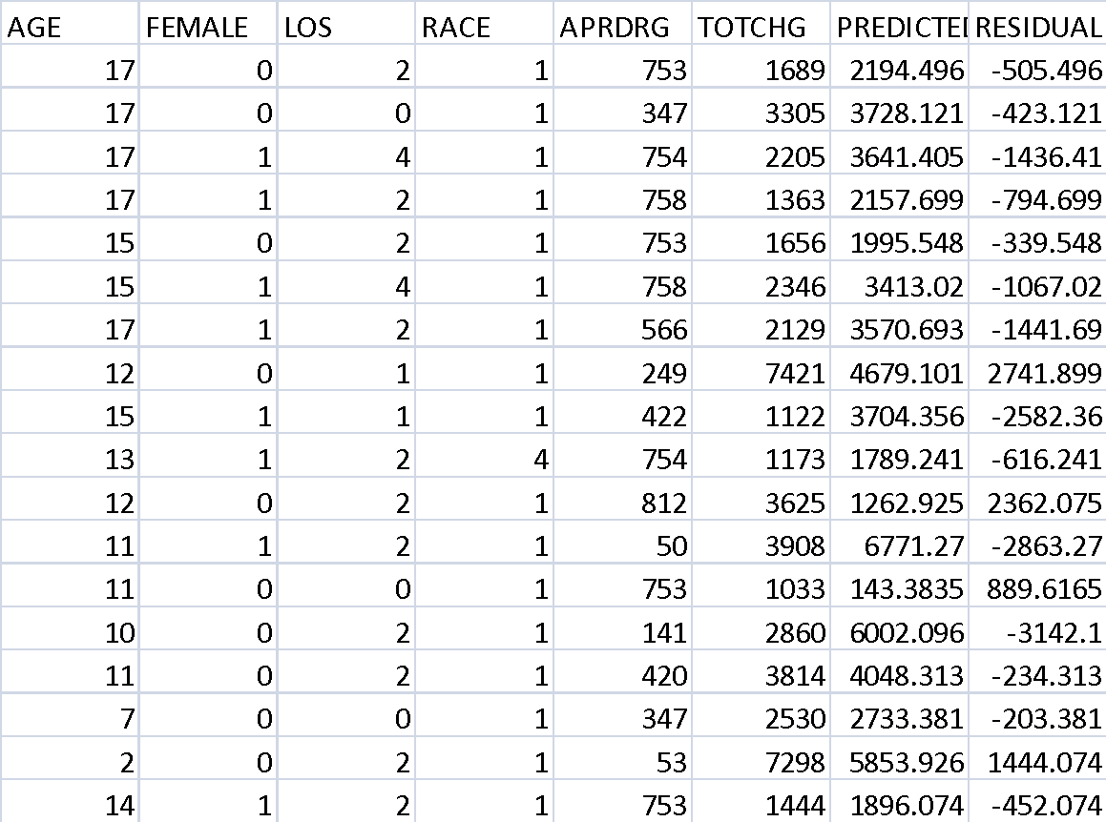
CONCLUSION OF MODEL
CONCLUSION :- THE LOWER RESIDUAL VALUE SHOWS THAT BETTER IS THE PREDICTIVE ACCURACY OF MODEL , VIVEVERSA .
RESULT :- https://drive.google.com/open?id=1SW63z4TrLge7EJfDqjqqKRjsUYY4hZY8

